Slide 1
FEMALE GENITAL MUTILATION/ CUTTING

Slide 2
Female genital mutilation/cutting (FGM/C) refers to all procedures involving partial or total removal of the external female genitalia or other injury to the female genital organs for non-medical reasons.
According to a recent UNICEF publication at least 200 million girls and women have experienced FGM/C in 30 countries across three continents. But without far more intensive and sustained action now from all parts of society, hundreds of millions more girls will suffer profound, permanent, and utterly unnecessary harm. If rates of decline seen in the past three decades are sustained, the impact of population growth means that up to 63 million more girls could be cut by 2050.
Overall, an adolescent girl today is about a third less likely to be cut than 30 years ago. Kenya and Tanzania have seen rates drop to a third of their levels three decades ago through a combination of community activism and legislation. In the Central African Republic, Iraq, Liberia and Nigeria, prevalence has dropped by as much as half. Attitudes are also changing: recent data show that the majority of people in the countries where FGM is practiced believe it should end, but continue to compel their daughters to undergo the procedure because of strong social pressure.

Slide 3
FGM/C may cause severe pain and can result in prolonged bleeding, infection, infertility and even death. A 2006 World Health Organization’s study found that FGM/C is also harmful to newborns due to adverse obstetric outcomes, leading to an extra 1 to 2 perinatal deaths per 100 deliveries.
FGM/C is a fundamental violation of the rights of girls and is typically upheld by a deeply entrenched social norm, especially in areas where it is widespread. It is a manifestation of gender discrimination. The practice is perpetrated by families without a primary intention of violence, but is de facto violent in nature. Communities practice FGM/C in the belief that it will ensure a girl's proper upbringing, future marriage or family honor. Some also associate it with religious beliefs although no religious scriptures require it. In many contexts, the social norm upholding the practice is so powerful that families have their daughters cut even when they are aware of the harm it can cause. If families were to stop practicing on their own they would risk the marriage prospects of their daughter as well as the family's status.

Slide 4
HONOR KILLING

Slide 5
Human Rights Watch defines "honor killings" as follows:
Honor killings are acts of vengeance, usually death, committed by male family members against female family members, who are held to have brought dishonor upon the family. A woman can be targeted by (individuals within) her family for a variety of reasons, including: refusing to enter into an arranged marriage, being the victim of a sexual assault, seeking a divorce—even from an abusive husband—or (allegedly) committing adultery. The mere perception that a woman has behaved in a way that "dishonors" her family is sufficient to trigger an attack on her life.
Although rarely, men can also be the victims of honor killings by members of the family of a woman with whom they are perceived to have an inappropriate relationship. The loose term "honor killing" applies to killing of both men and women in cultures that practice it.

Slide 6
Some women who bridge social divides, publicly engage other communities, or adopt some of the customs or the religion of an outside group may be attacked. In countries that receive immigrants, some otherwise low-status immigrant men and boys have asserted their dominant patriarchal status by inflicting honor killings on female family members who have participated in public life, for example, in feminist and integration politics.
The distinctive nature of honor killings is the collective nature of the crime - many members of an extended family plan the act together, sometimes through a formal "family council". Another significant feature is the connection of honor killings to the control of women’s behavior, in particular in regard to sexuality/male interaction/marriage, by the family as a collective. Another key aspect is the importance of the reputation of the family in the community, and the stigma associated with losing social status, particularly in tight-knit communities. Another characteristic of honor killings is that the perpetrators often don't face negative stigma within their communities, because their behavior is seen as justified.

Slide 7
The incidence of honor killings is very difficult to determine and estimates vary widely. In most countries data on honor killings is not collected systematically, and many of these killings are reported by the families as suicides or accidents and registered as such. Although honor killings are often associated with the Asian continent, especially the Middle East and South Asia, they occur all over the world. In 2000, the United Nations estimated that 5,000 women were victims of honor killings each year. According to BBC, "Women's advocacy groups, however, suspect that more than 20,000 women are killed worldwide each year." Murder is not the only form of honor crime, other crimes such as acid attacks, abduction, mutilations, beatings occur; in 2010 the UK police recorded at least 2,823 such crimes
Methods of killing include stoning, stabbing, beating, burning, beheading, hanging, throat slashing, lethal acid attacks, shooting and strangulation. The murders are sometimes performed in public to warn the other women within the community of possible consequences of engaging in what is seen as illicit behavior.

Slide 8
CHILD BRIDES

Slide 9
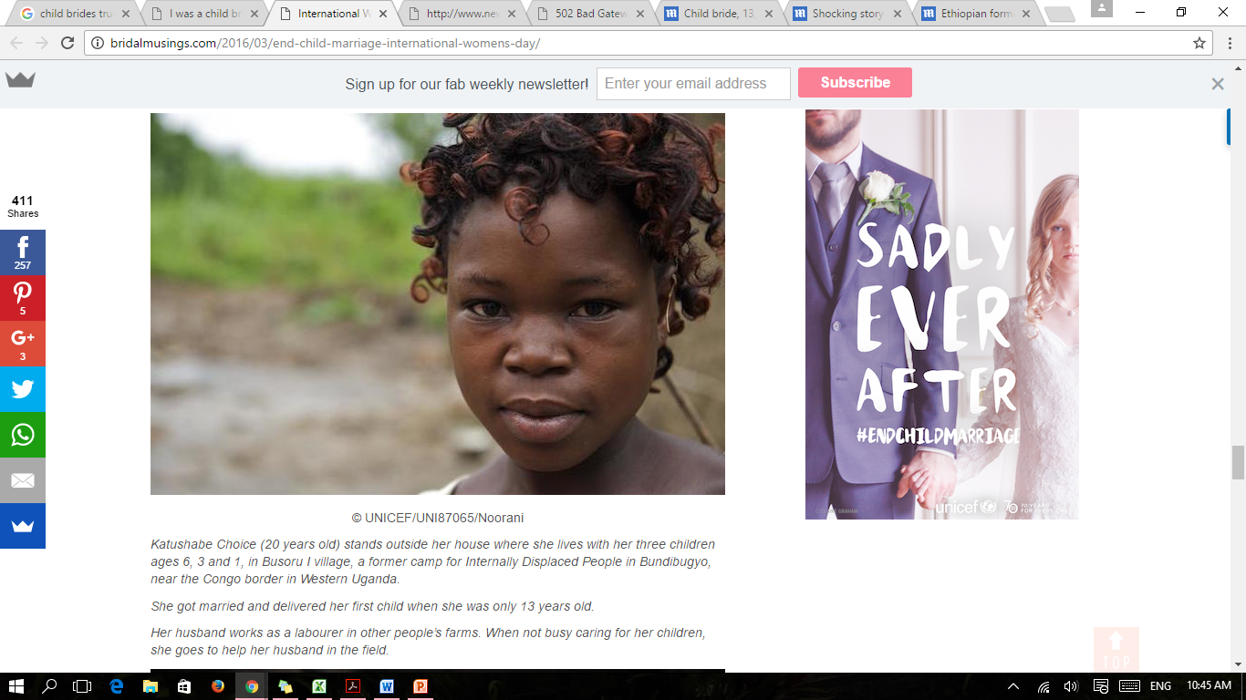

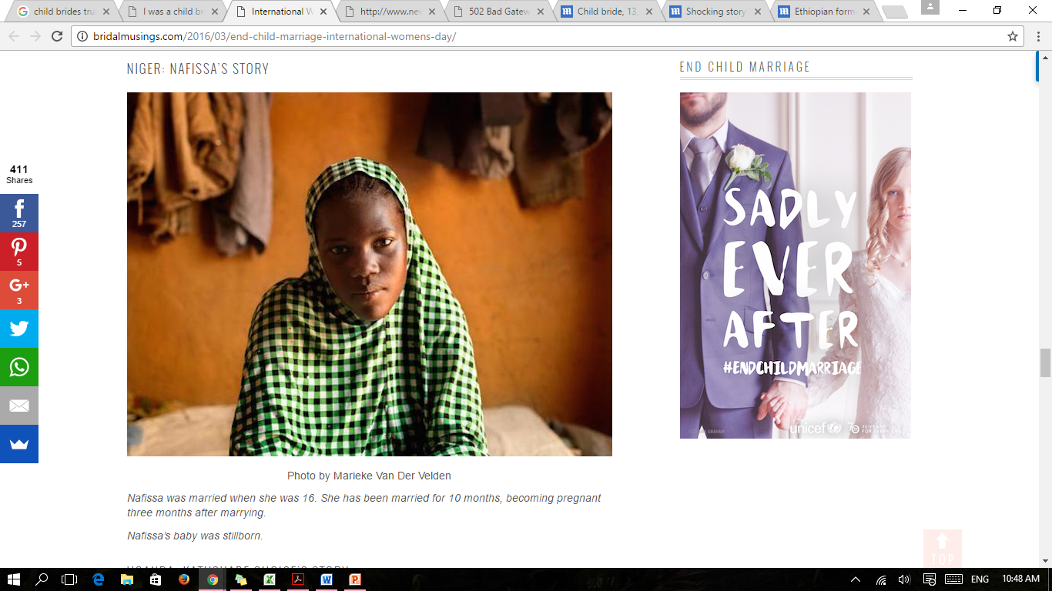
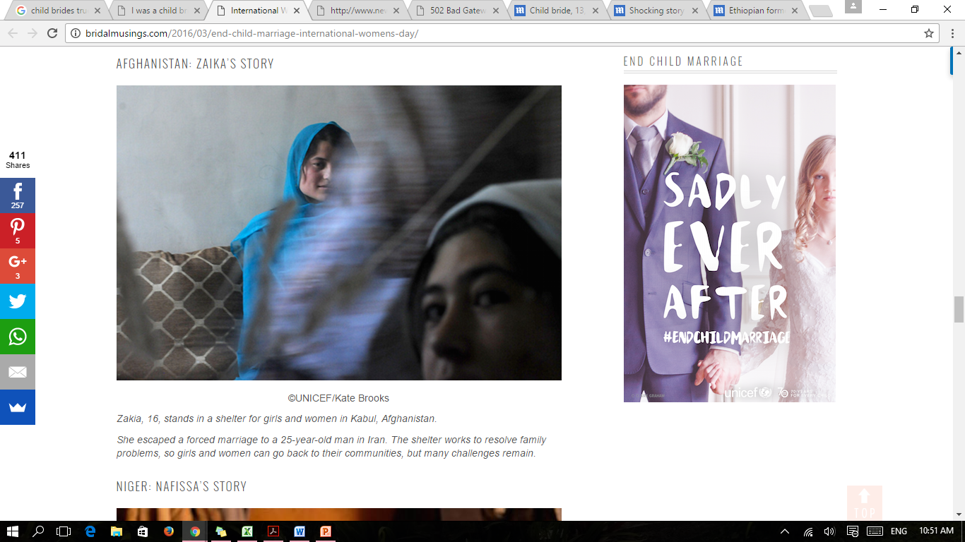
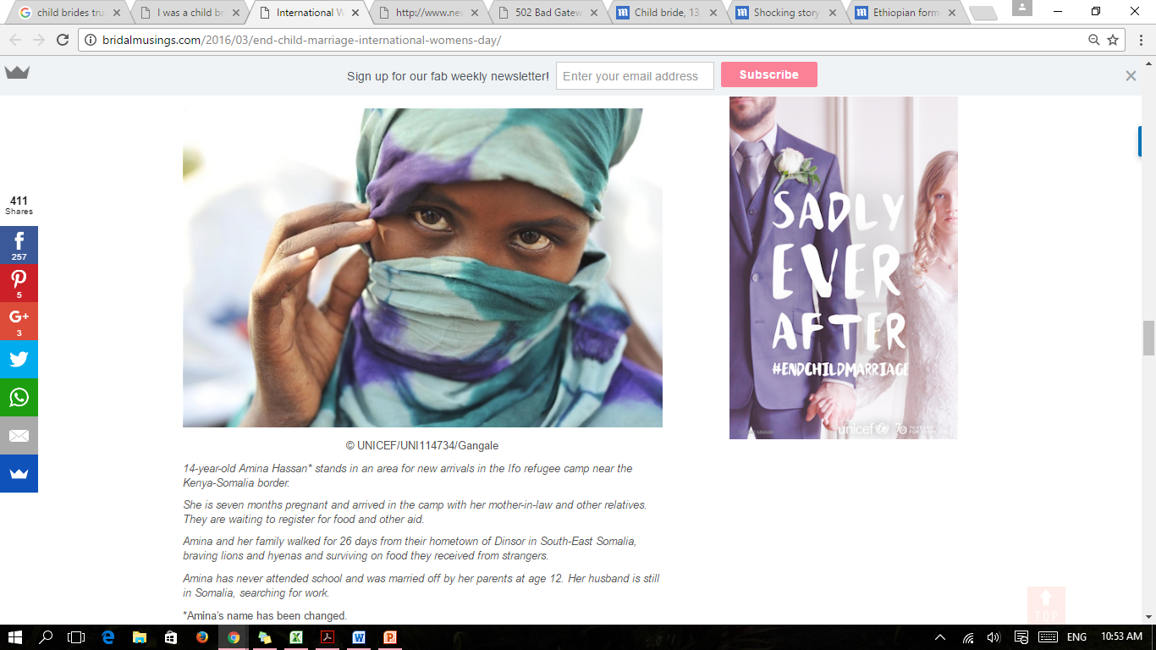
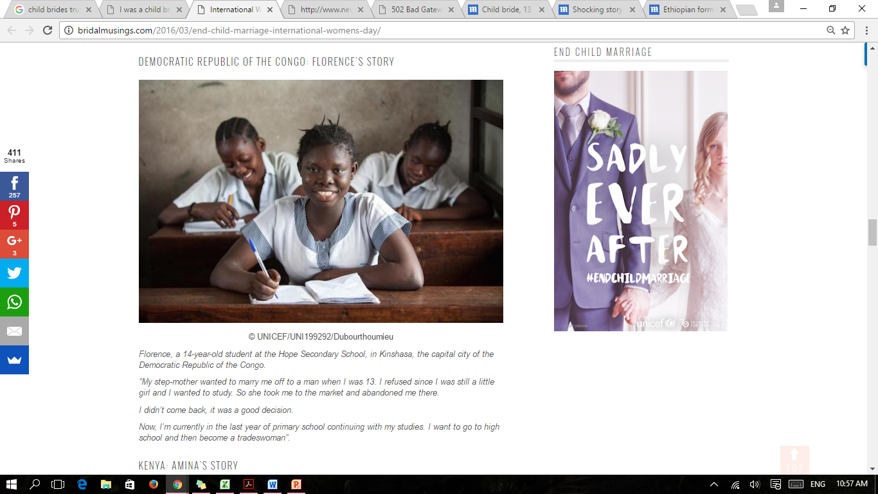

Slide 12
Notes:
Niger

Slide 13
Notes:
Afghanistan

Slide 14
Notes:
Kenya

Slide 16
Worldwide, more than 700 million women alive today were married as children. More than 1 in 3 – or some 250 million – were married before 15. Girls who marry before they turn 18 are less likely to remain in school and more likely to experience domestic violence. Young teenage girls are more likely to die due to complications in pregnancy and childbirth than women in their 20s; their infants are more likely to be stillborn or die in the first month of life.
While data from 47 countries show that, overall, the median age at first marriage is gradually increasing, this improvement has been limited primarily to girls of families with higher incomes. But without far more intensive and sustained action now from all parts of society, hundreds of millions more girls will suffer profound, permanent, and utterly unnecessary harm

Slide 17
Evidence shows that girls who marry early often abandon formal education and become pregnant. Maternal deaths related to pregnancy and childbirth are an important component of mortality for girls aged 15–19 worldwide, accounting for 70,000 deaths each year (UNICEF, 2009). If a mother is under the age of 18, her infant’s risk of dying in its first year of life is 60 per cent greater than that of an infant born to a mother older than 19. Even if the child survives, he or she is more likely to suffer from low birth weight, under nutrition and late physical and cognitive development. Child brides are at risk of violence, abuse and exploitation. Finally, child marriage often results in separation from family and friends and lack of freedom to participate in community activities, which can all have major consequences on girls’ mental and physical well-being.
Where prevalent, child marriage functions as a social norm. Marrying girls under 18 years old is rooted in gender discrimination, encouraging premature and continuous child bearing and giving preference to boys’ education. Child marriage is also a strategy for economic survival as families marry off their daughters at an early age to reduce their economic burden.

